Slide 1

EasyWay
Subject: CS691
Computer Science Project 1
Presentation Designed by:
Vidisha Vijay Sawant

Slide 2

Agenda

Slide 3
Agenda
Improvement from Professor’s Feedback.
Problem Statement.
Project Description
Personas
MVP
Technologies
Architecture Diagram
Sprint 2 Recap
Product Backlog
Sprint Backlog
Metrics
Retrospective
Sprint 4
Project Demo
Live Application Demo

Slide 4
Professor Feedback from the previous deliverable.
1: Feedback should be presented in bullet points.
2: Presentation designer’s name should be mentioned.
3: Photos in personas should be from an Open source.
4: Acceptance Criteria should be renamed to User Stories in Excel.
5: The issue type needs to be replaced with the User Story key.
6: Few User Stories should be explained and not all of them.
7: Test cases ID should be replaced with User Story ID.
8: Sprint backlog should be presented before the next sprint.
9: User Story and Task symbols should be corrected in Jira.
10: Demo Should be a part of the Sprint review.
11: ‘Next sprint schedule' slide should be presented before the 'stories completed’ slide.
12: Team members’ velocity chart (GitHub) is not needed in the presentation.
13: Retrospective should be improved (What went well, what didn’t go well and next steps).
14: Stories planned for Sprint-3 are not needed in the Sprint-2 presentation.
15: The sprint-2 schedule should be presented in a tabular form instead of a screenshot.
Post the deliverable 2 presentation, we received feedback from the professor which is mentioned here:

Slide 5

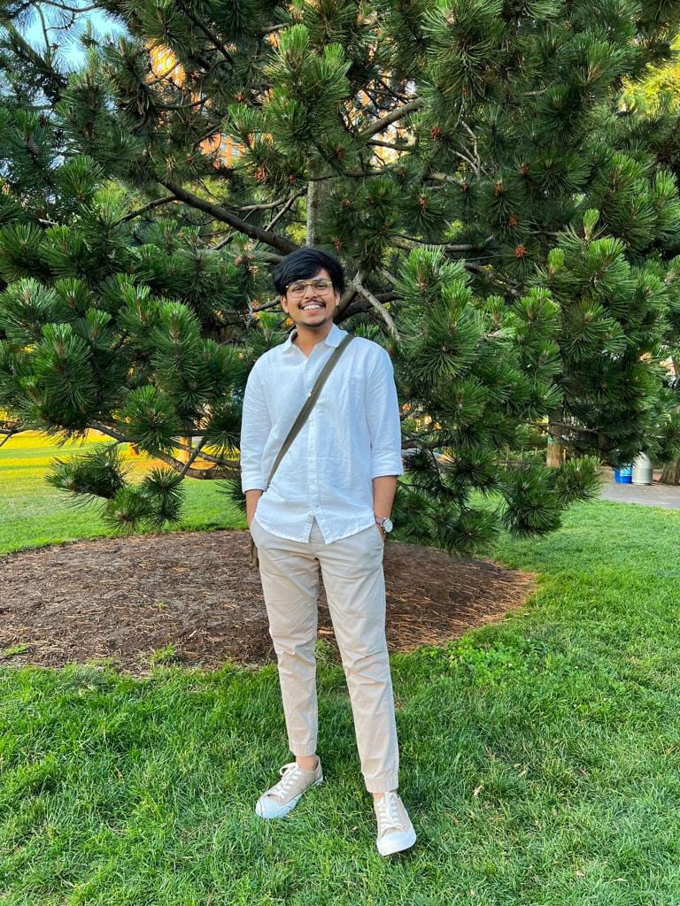

Team Member Roles
Aditya Kadarla
Project Manager
Quality Analyst & Tester
Shubham Sawant
Business Analyst & Developer
Ravi Kumar Dabbada
Database Administrator

Slide 6

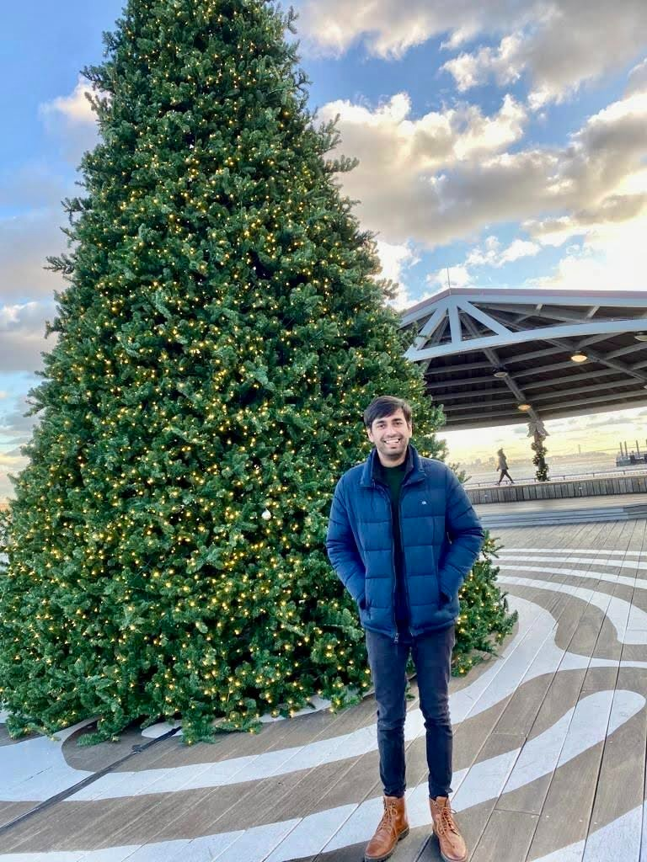
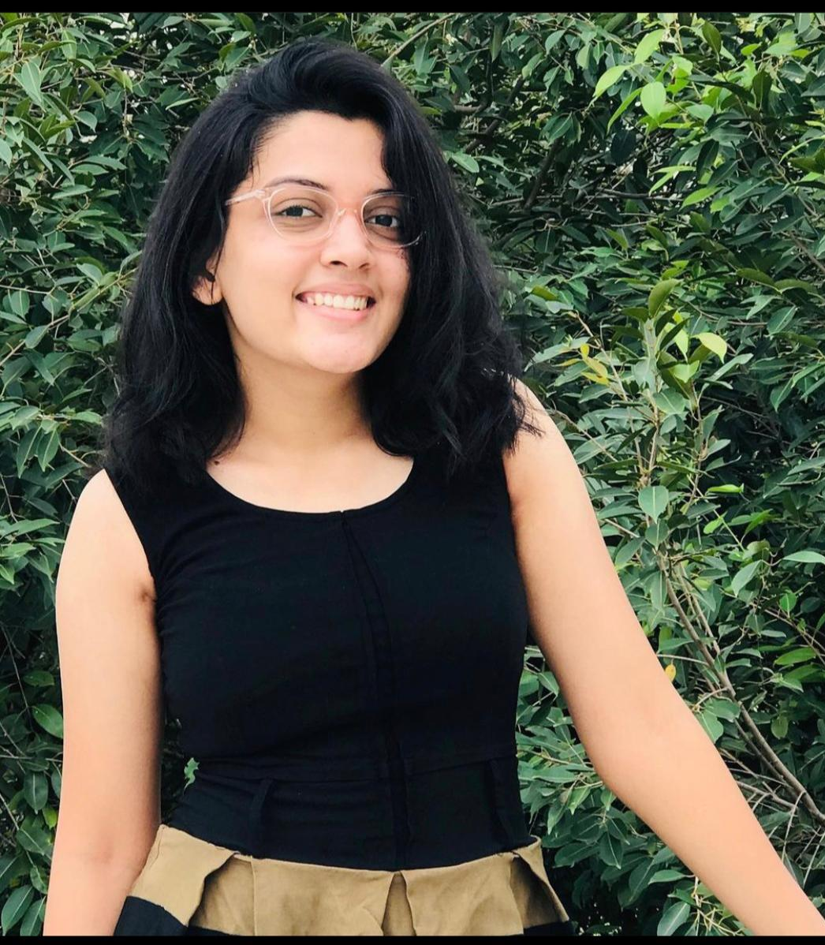
Team Member Roles
Vidisha Vijay Sawant
Developer
Kshitij Sharma
Developer
Femina Baldha
Developer

Slide 7

Problem Statement
Home services are an age-old concept. The “old way” of availing local home services was for servicemen (“handymen”) to market themselves through word of mouth, and then to use listing services such as Yelp. Local home services are inherently disorganized, with individuals usually running business operations. Services range from carpentry, plumbing, beauty, laundry, and so on. Think of anything you need in your home, that can’t be solved by buying a product. That is likely going to be solved by home services.
The trouble is, home services are not a commodity.
The core reason why people continued to rely on word of mouth after bad experiences, was because it was impossible to tell what you were getting into, even for something as “basic” as plumbing. How do you know the carpenter is good, or the plumber will do a good job? Sure, the industry is ripe for disruption, but how would it get disrupted?

Slide 8

Project Description
The “EasyWay" web application aims to aggregate utility services such as beauty, electrical maintenance, home cleaning, pest control, etc. The application would enable the end-user to select their preferred service, book an appointment at a convenient time, pay the resultant charge and give feedback. The application aims to be a one-stop shop that caters to all the utility needs of the end user. Our product promises easy booking and cancellation without extra changes, and you can maintain your booked services in one place easily.

Slide 9

PERSONAS

Slide 10
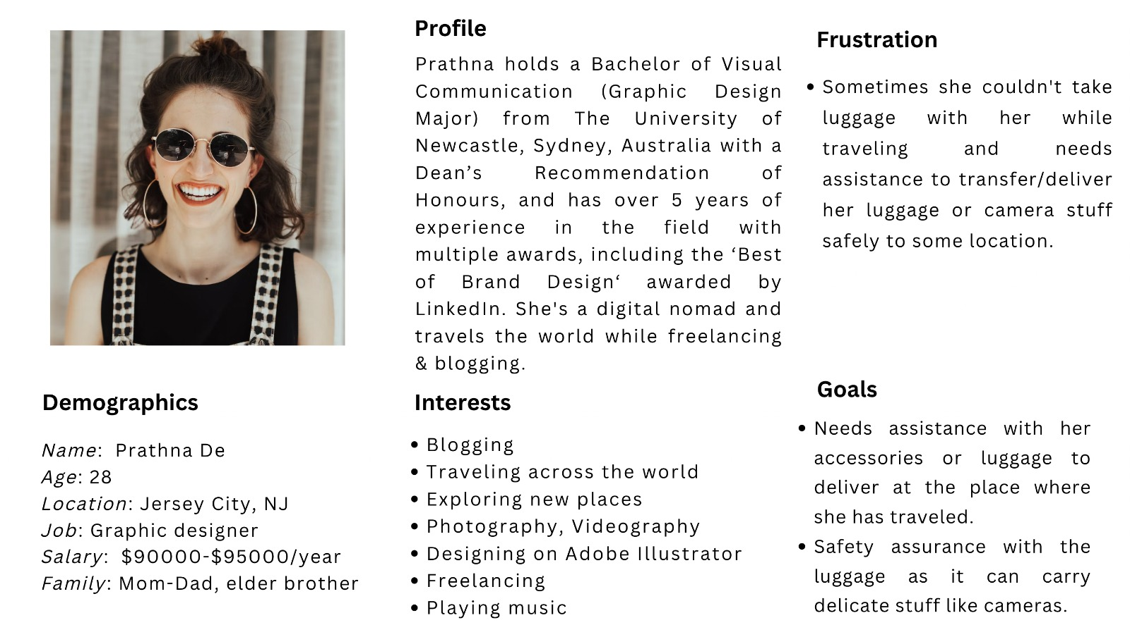
Persona 1

Slide 11
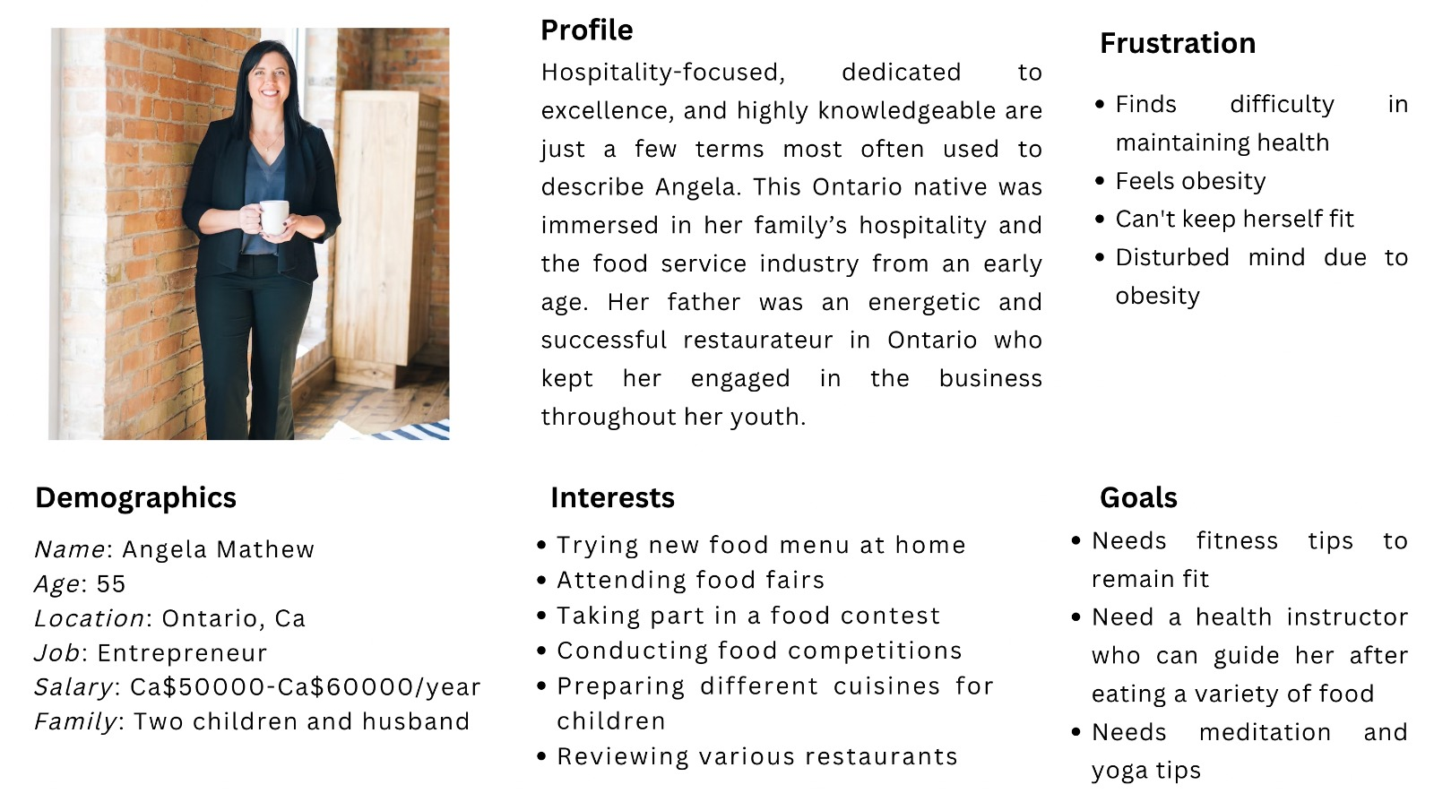
Persona 2

Slide 12
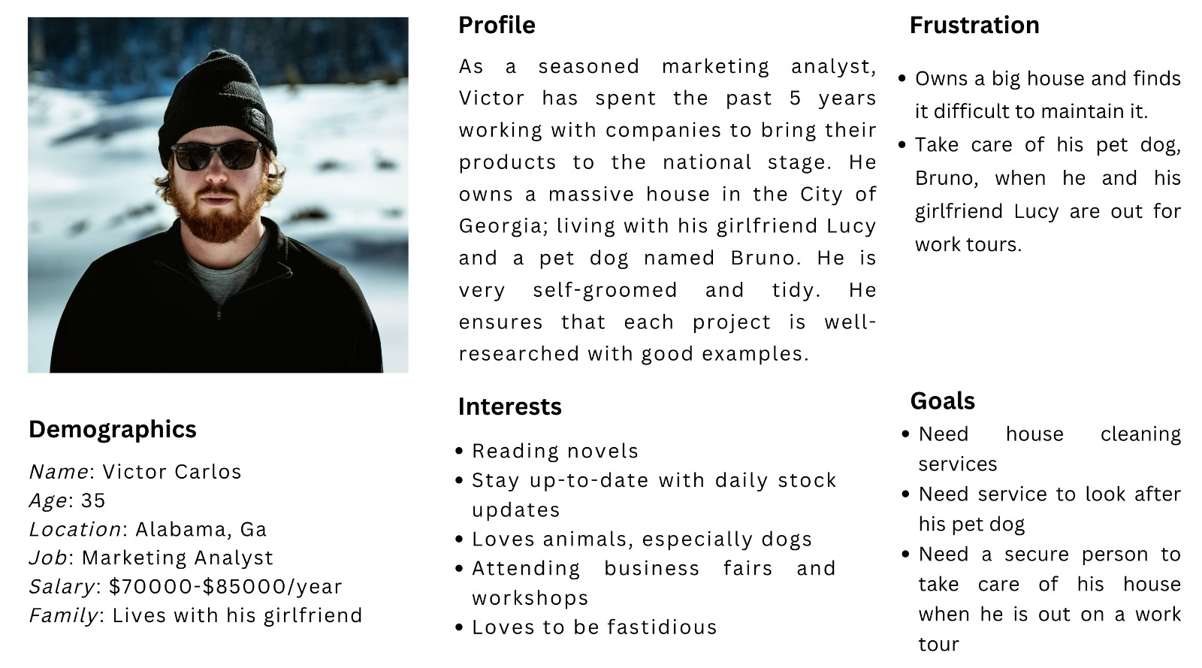
Persona 3

Slide 13


Slide 14
Minimum Viable Product (MVP)
Homepage
Service Catalog
Edit Booking or Cancel Booking
Registration - Customer and Professional
Login - Customer and Professional
Book - Calendar, and Time
Booking Confirmation via email or in-app

Slide 15
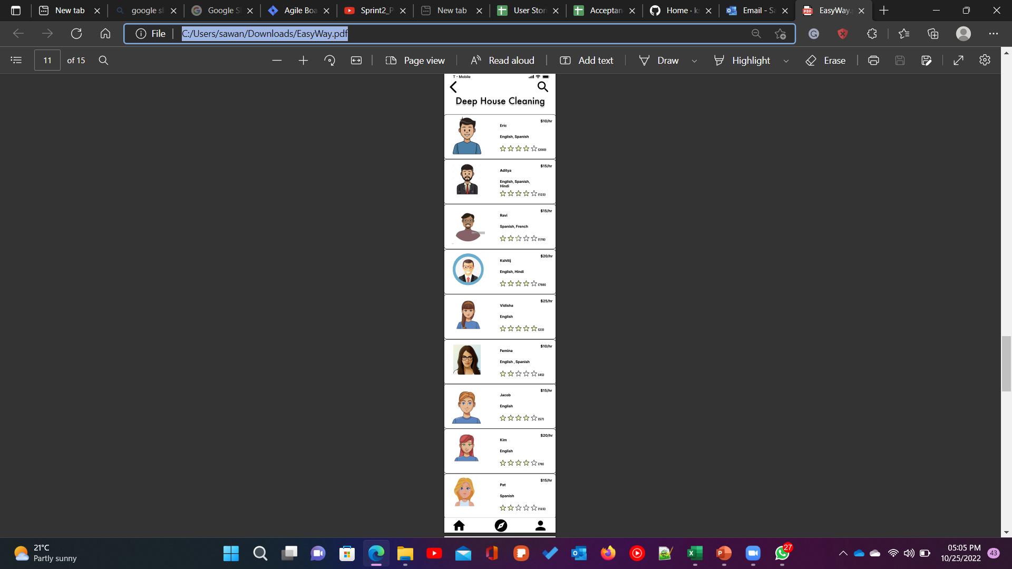
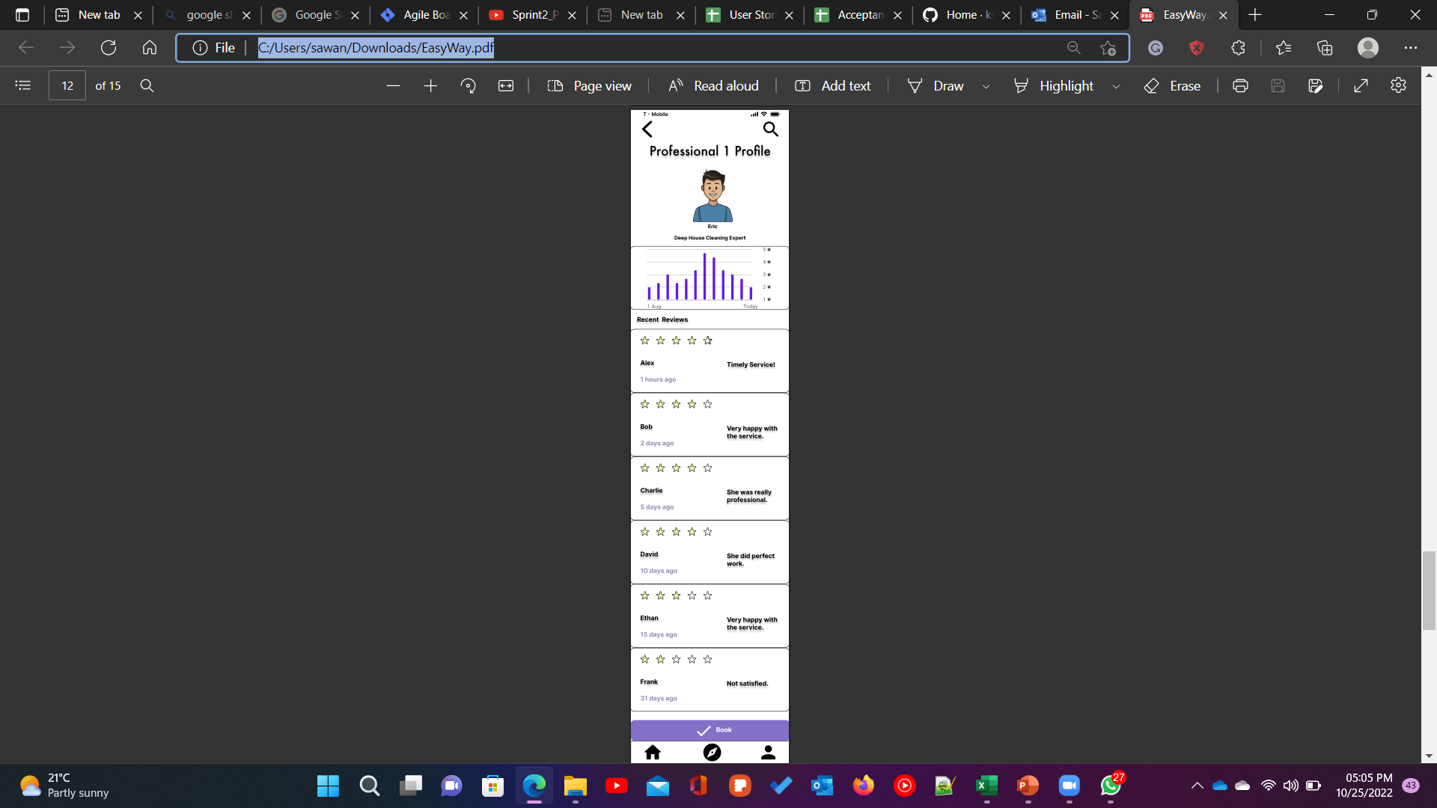
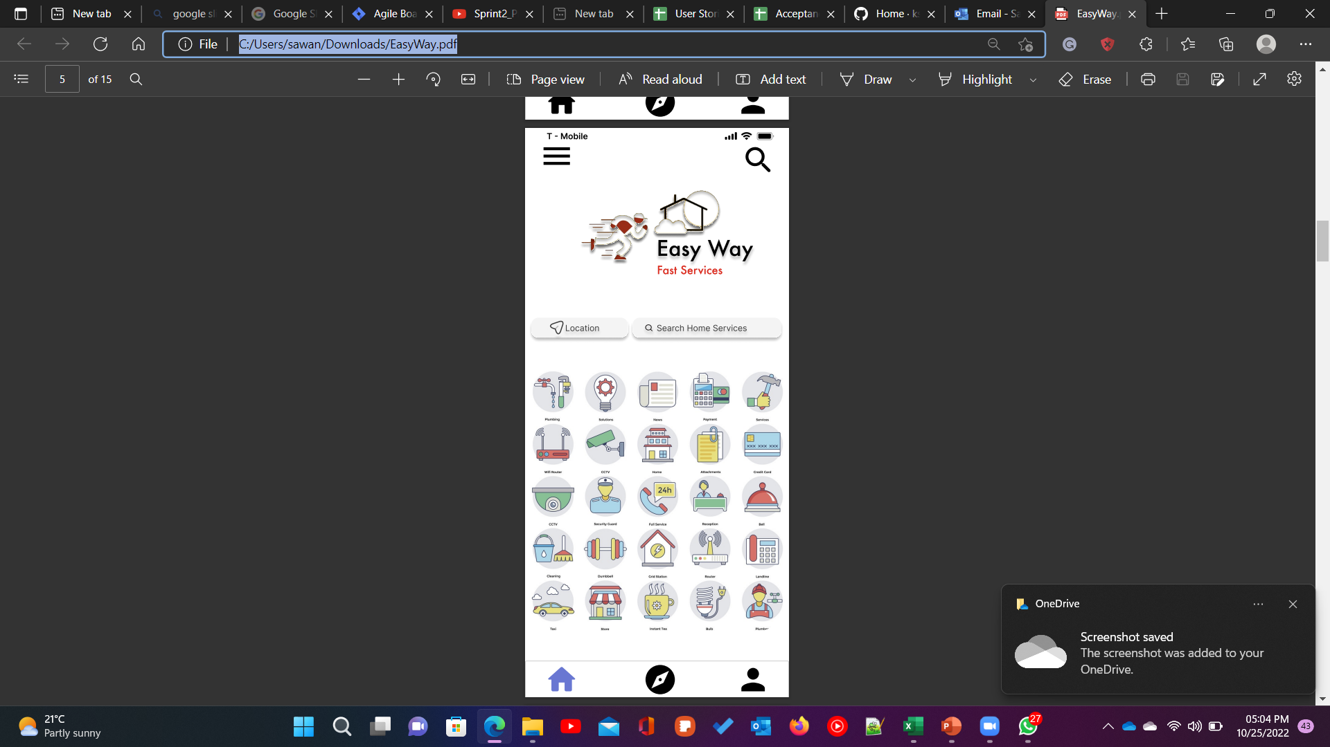
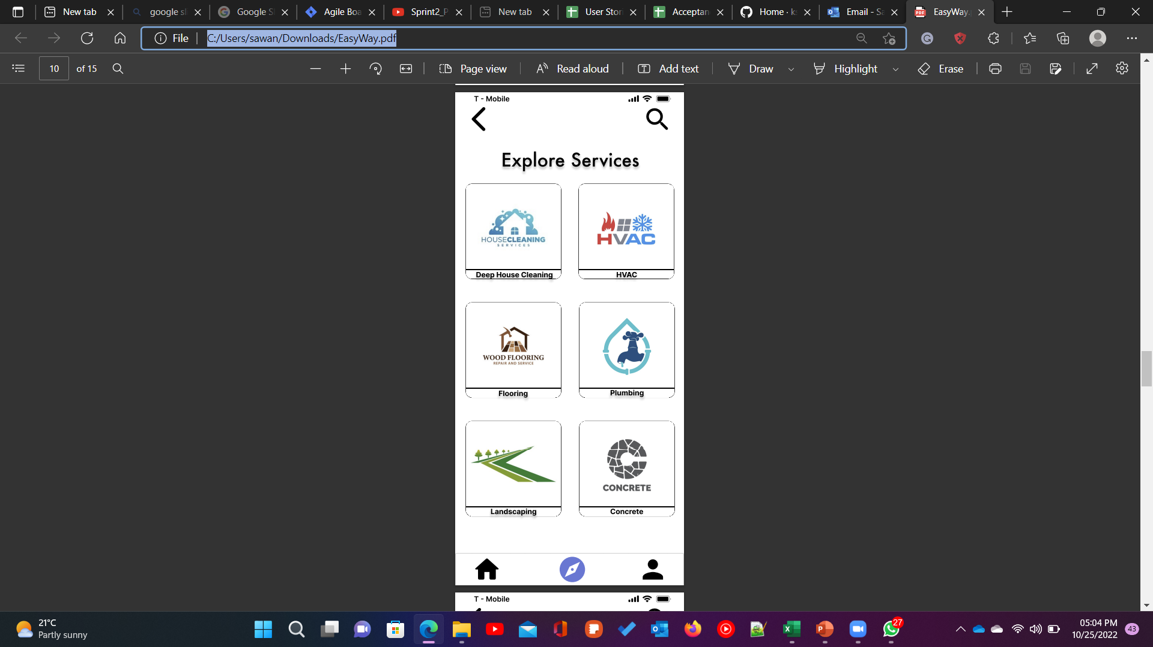
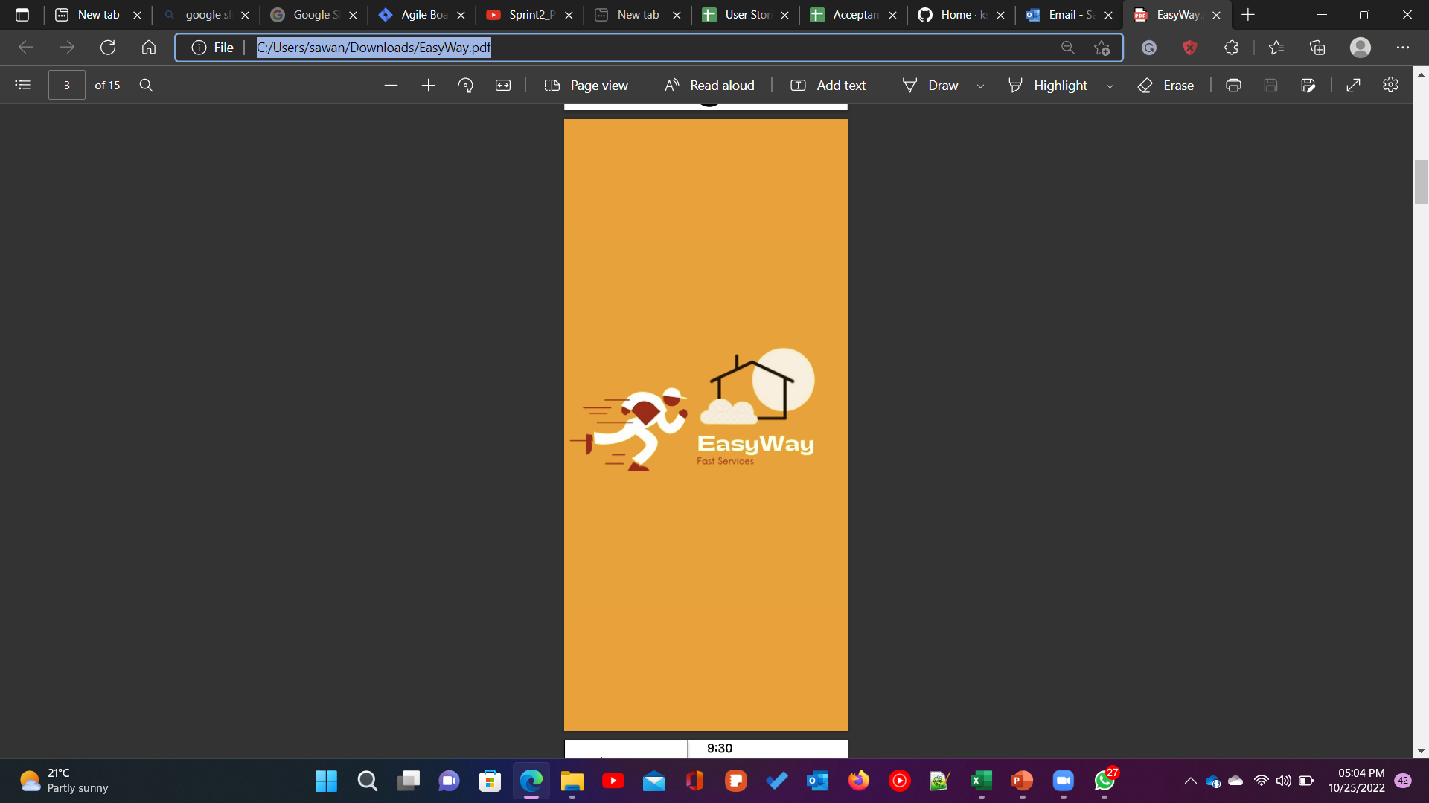
Minimal Viable Product (MVP)

Slide 16
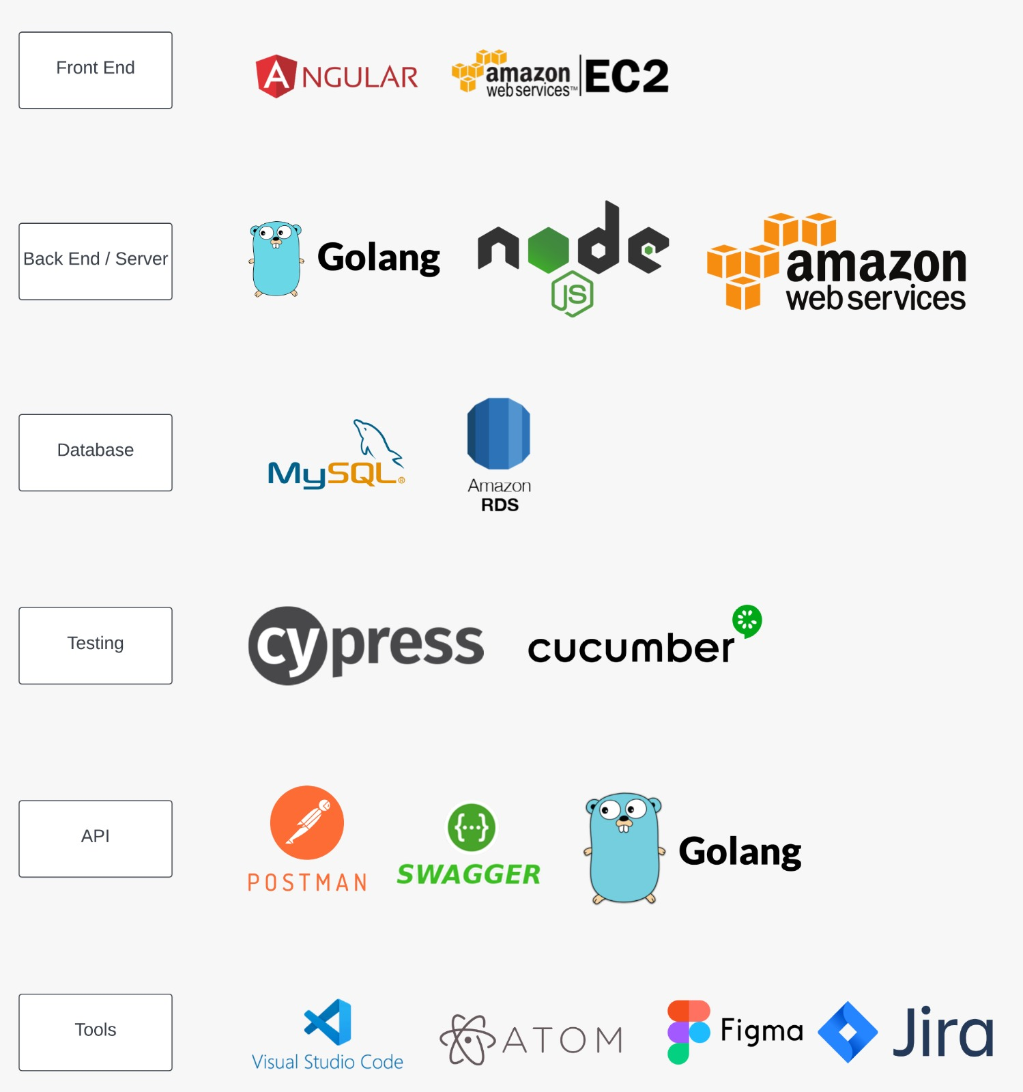
Technologies

Slide 17

Architecture Diagram

Slide 18
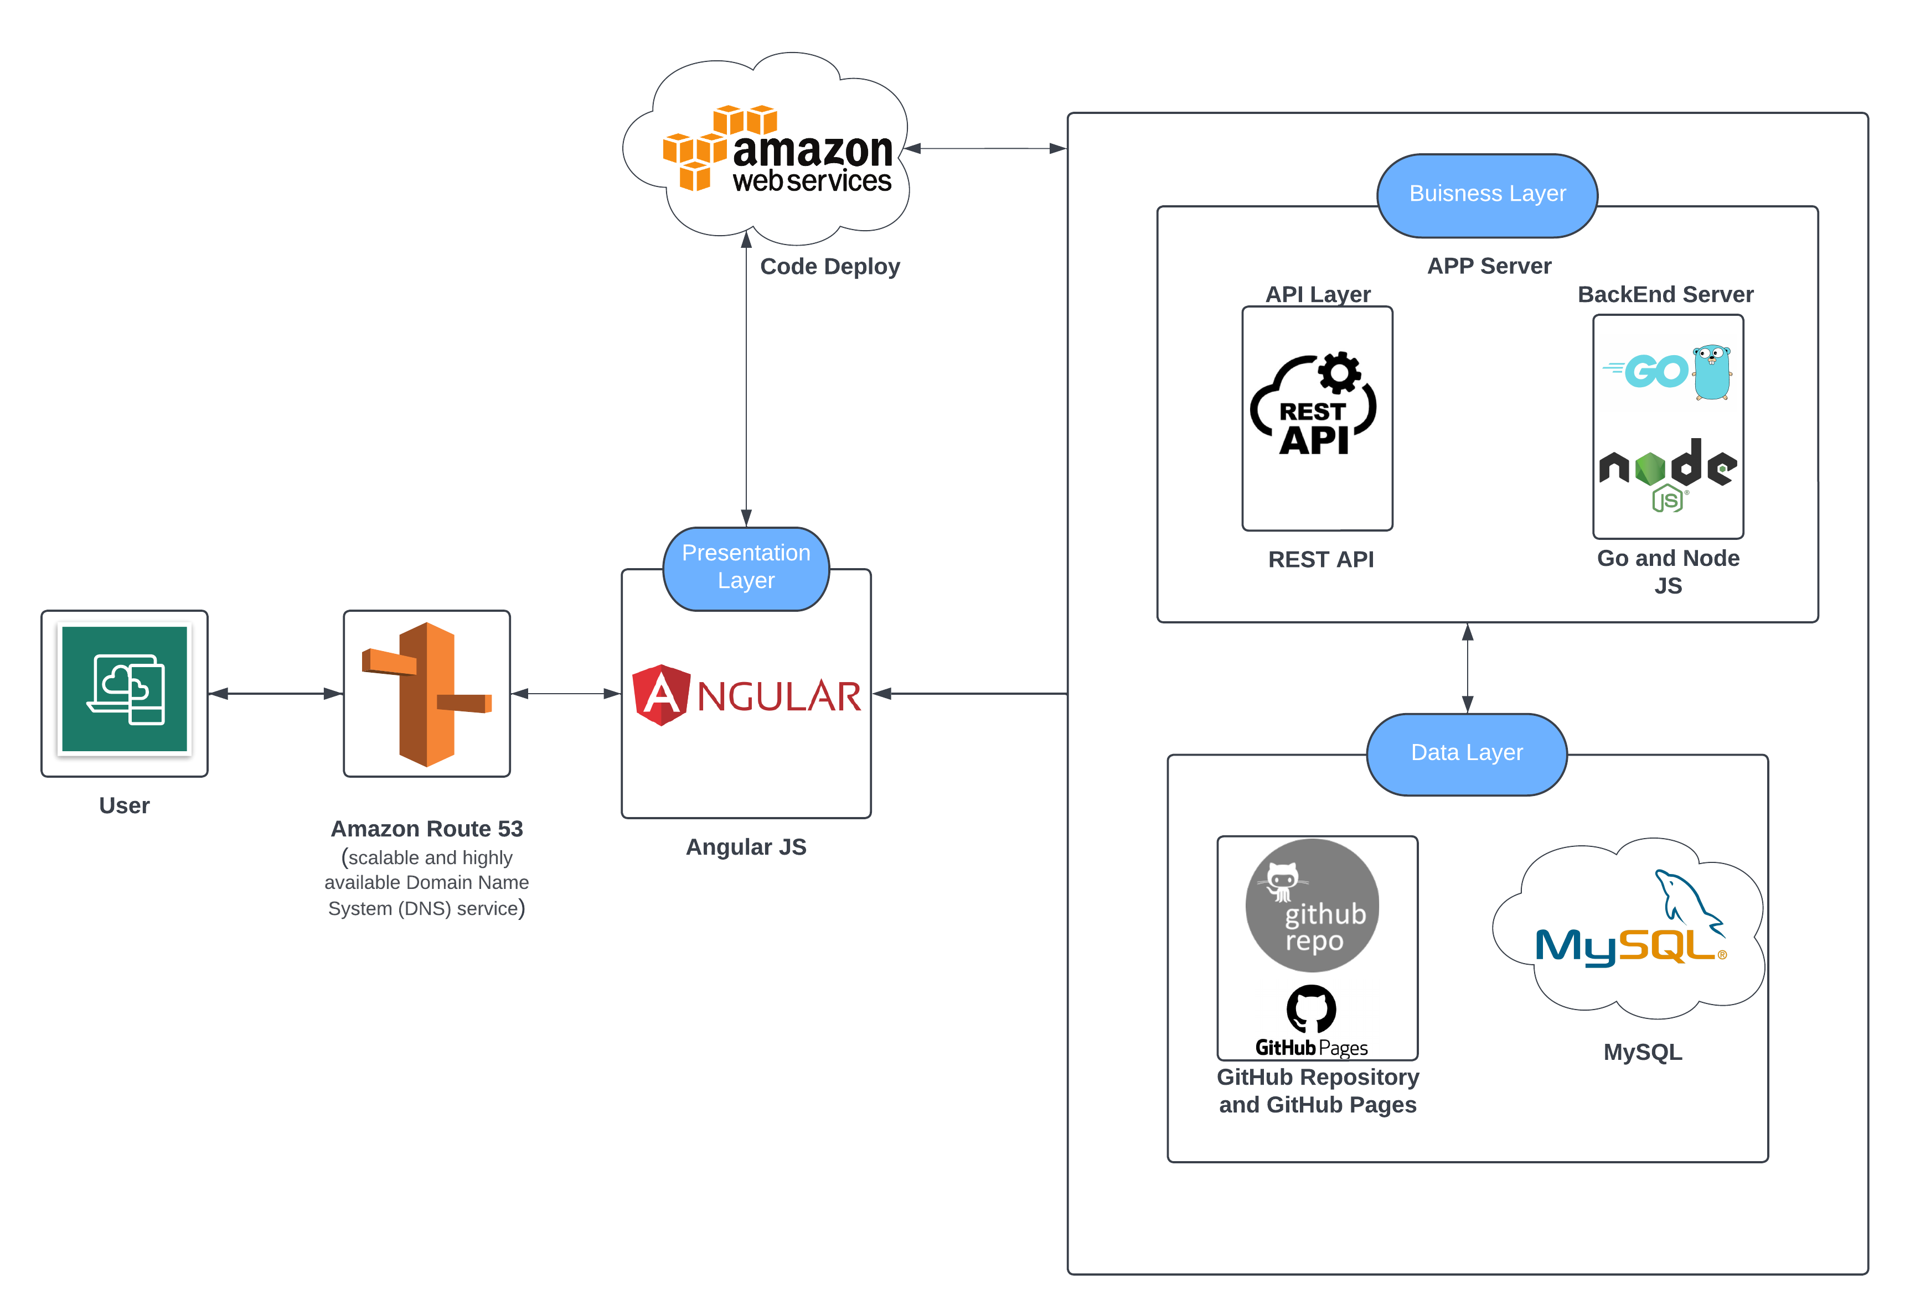
Conceptual Architecture Diagram

Slide 19
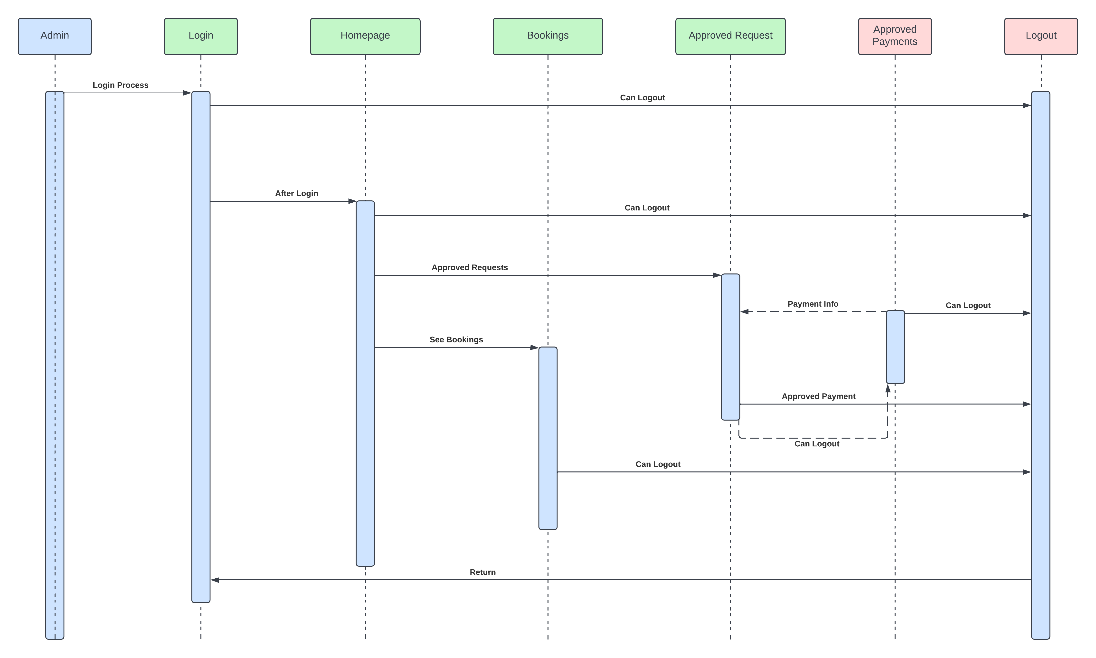
Admin Sequence Architecture Diagram

Slide 20
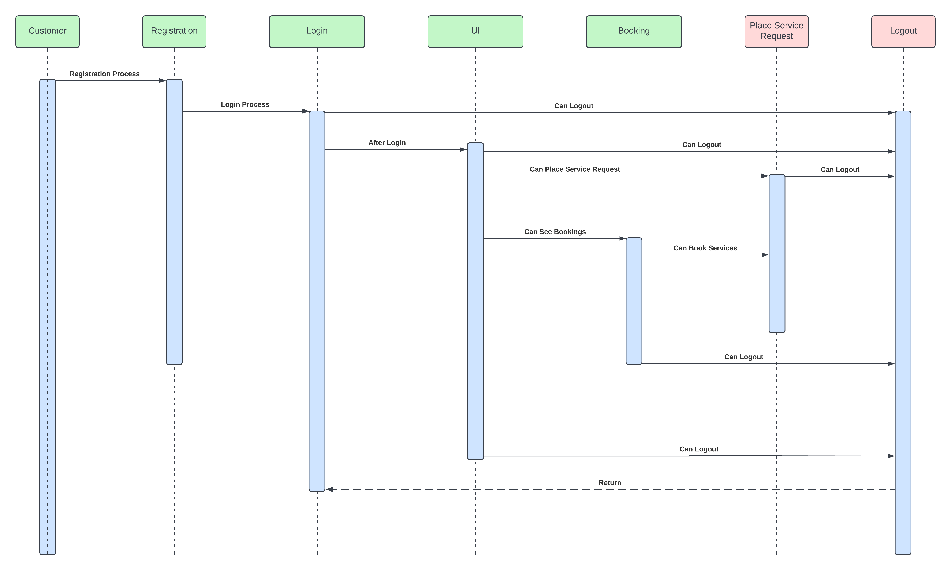
User Sequence Architecture Diagram

Slide 21

Sprint 2 Recap

Slide 22
Sprint 2 Vs Sprint 3
Login
Registration
Homepage
Service Catalog
Customer Profile

Slide 23
Product Backlog
Issue Type | Key | Name
Story | DCS-47 | As a customer, I want to be able to find all the quick links in one place/or at the bottom of the page So that I will be able to access the links and find necessary information
Story | DCS-46 | As a customer, I want to email customer service So that I can get my issue resolved
Story | DCS-45 | As a customer I want to browse all the professional home services provided. So that I have a list to select the service I want.
Story | DCS-44 | As a customer I want to able to recover the passwords to my account So that I will be able to access my account in case i forgot password.
Story | DCS-43 | As a customer I want to be able to recover my account customer ID/Name So that I will be able to access my account in case i forgot the account.
Story | DCS-42 | As a customer, I want to able to search on the webpage, So that I can find necessary information
Story | DCS-41 | As a customer I want to able to submit feedback So that the website owners can consider my opinion or concern during future website updates
Story | DCS-40 | As a customer I want to able to access quick services near me So that I will be able to book in a urgent situation at my house.
Story | DCS-39 | As a customer I want to be access the services according to categories such as water, furniture, beauty, etc So that I will be able to access the see the services available and who the professionals are
Story | DCS-38 | As a customer I want to be directly able to contact the technician via call/text So that I will be able to have a better service
Story | DCS-37 | As a customer, I want to be able to prepone or postpone my booked service So that I can expect the professional on some other date or time.
Story | DCS-36 | As a customer, I want to be able to cancel my booked service So that I can not expect the professional to reach my home.
Story | DCS-35 | As a customer, I want to be able to add multiple address So that I can use them to schedule a service for my office.
Story | DCS-33 | As a customer, I want to browse the service list So that I can get some information what does this particular service do.
Story | DCS-32 | As a signed-in customer I want to able to comment on a blog post So that I can get feedback on issues
Story | DCS-31 | As a customer, I want to choose the date and time of service So that it is available at my convenience.
Story | DCS-29 | As a customer, I want to see the services booked by me So that I can track it.
Story | DCS-28 | As a customer, I want to book a service So that I can book an appointment.

Slide 24
Sprint Backlog
Issue Type | Key | Name
Story | DCS-51 | As a customer, I want to browse all the services provided by the app, So that I have a list of professionals to select from and book them accordingly.
Story | DCS-49 | As a customer, I want to create my profile, So that I can store my Name, Address, and Phone No. in it.
Story | DCS-48 | As a customer, I want to browse the service list, So that I will be able to see what services this app offers.
Story | DCS-18 | As a customer, I would like to have a landing page explaining all the features of the platform, So that I am motivated to register.
Task | DCS-17 | Draft Technical Paper

Slide 25
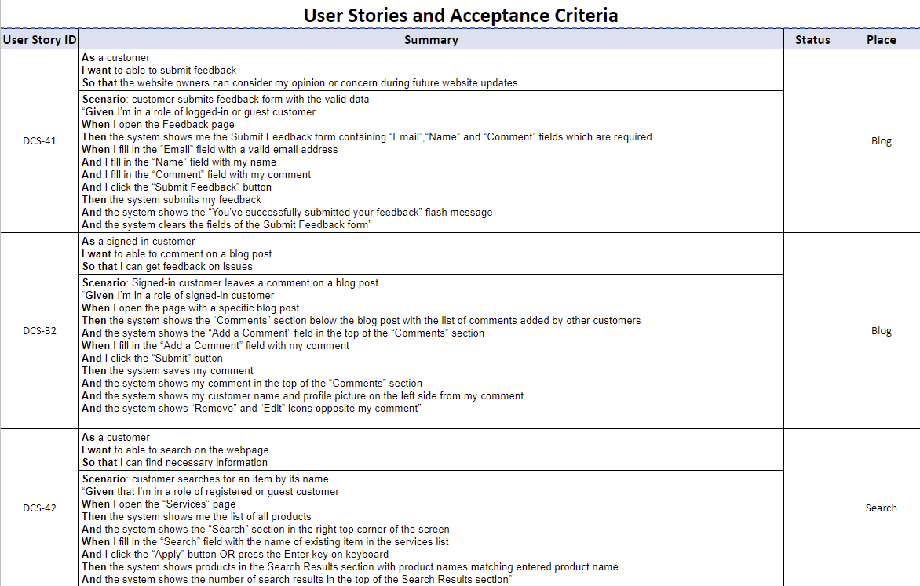
Stories and Acceptance Criteria

Slide 26
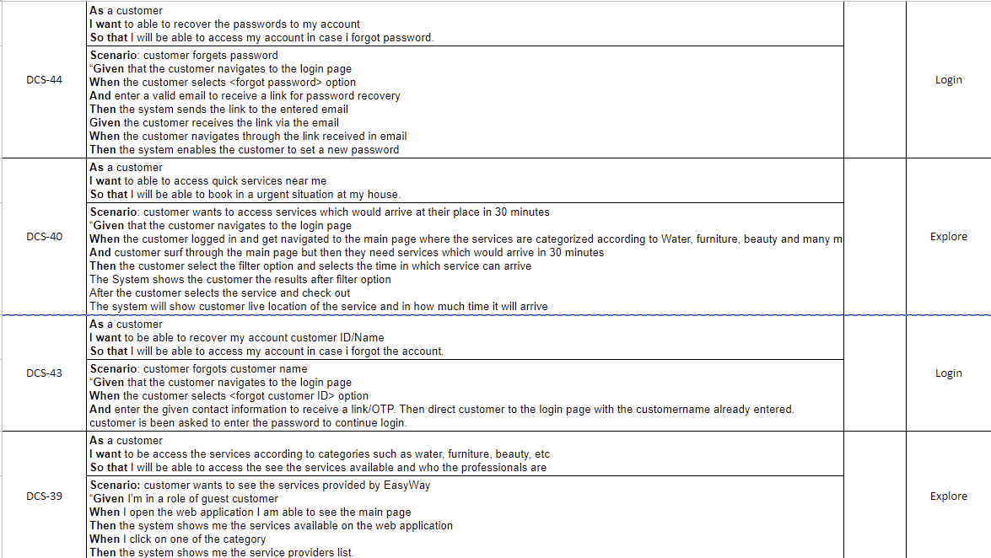
Stories and Acceptance Criteria

Slide 27
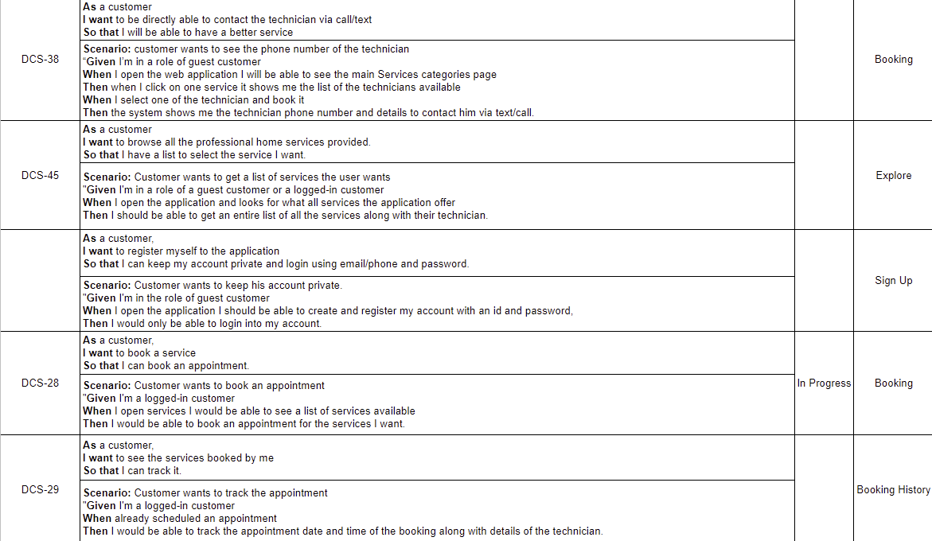
Stories and Acceptance Criteria
DCS-13

Slide 28
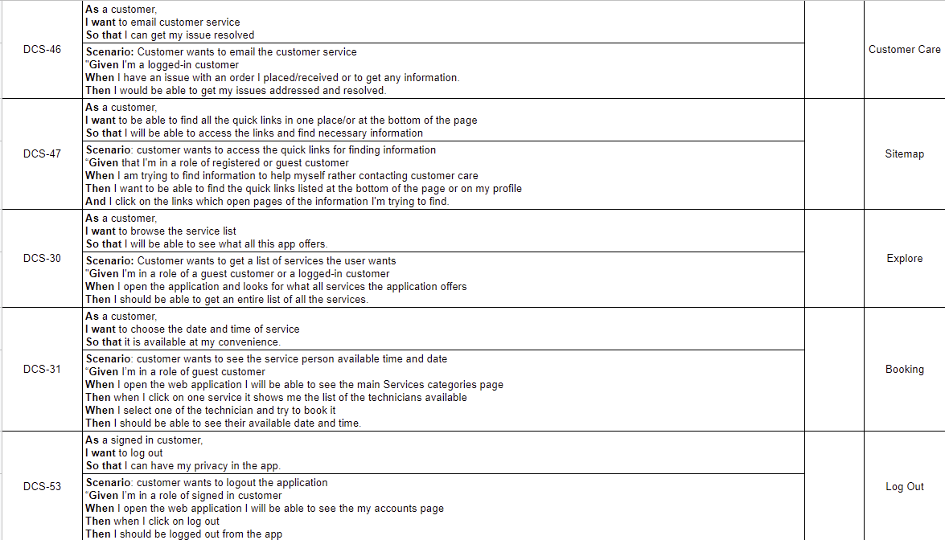
Stories and Acceptance Criteria

Slide 29
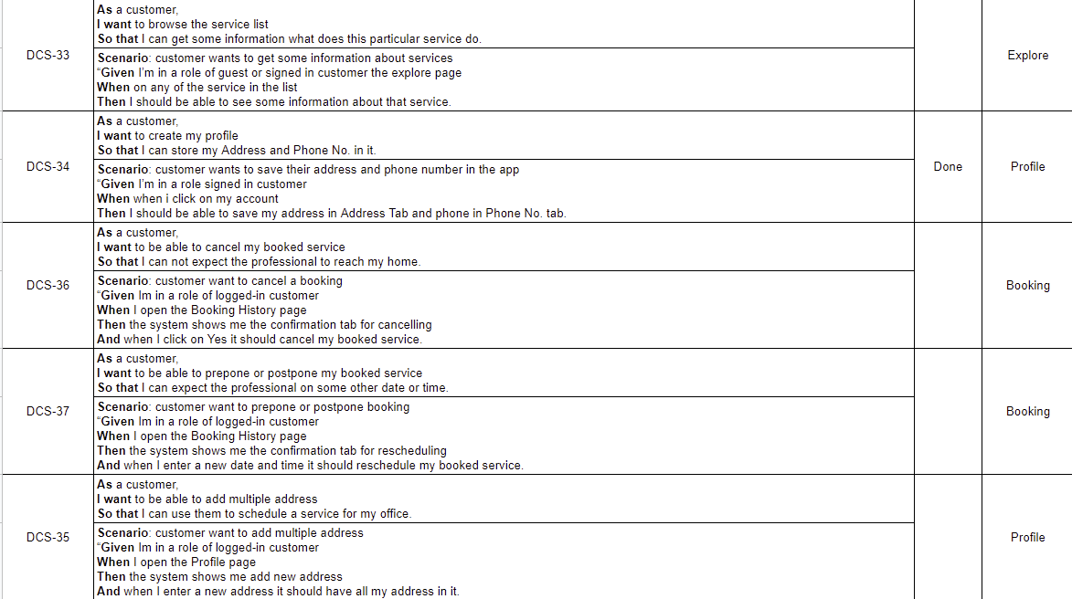
Stories and Acceptance Criteria

Slide 30
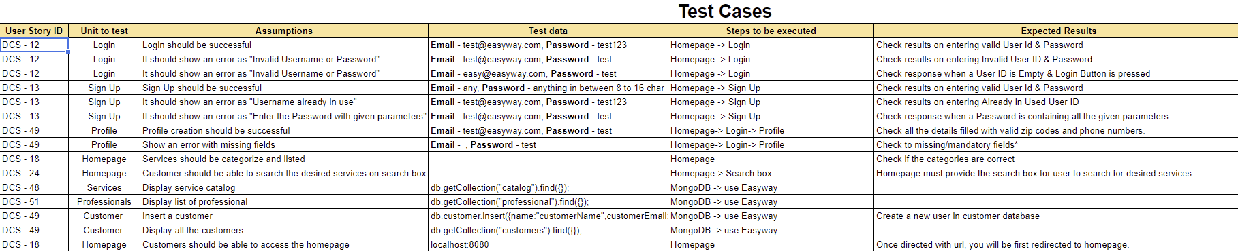
Test Cases

Slide 31
Stories Completed and Stories Not Completed
Name | Status | Date
As a customer, I want to browse all the services provided by the app, So that I have a list of professionals to select from and book them accordingly. | Done | 11/08/2022
As a customer, I want to create my profile, So that I can store my Name, Address, and Phone No. in it. | Done | 11/08/2022
As a customer, I would like to have a landing page explaining all the features of the platform, So that I am motivated to register. | Done | 11/08/2022
As a customer, I want to browse the service list, So that I will be able to see what services this app offers. | Done | 11/09/2022
Draft Technical Paper | Done | 11/11/2022

Slide 32

Metrics

Slide 33
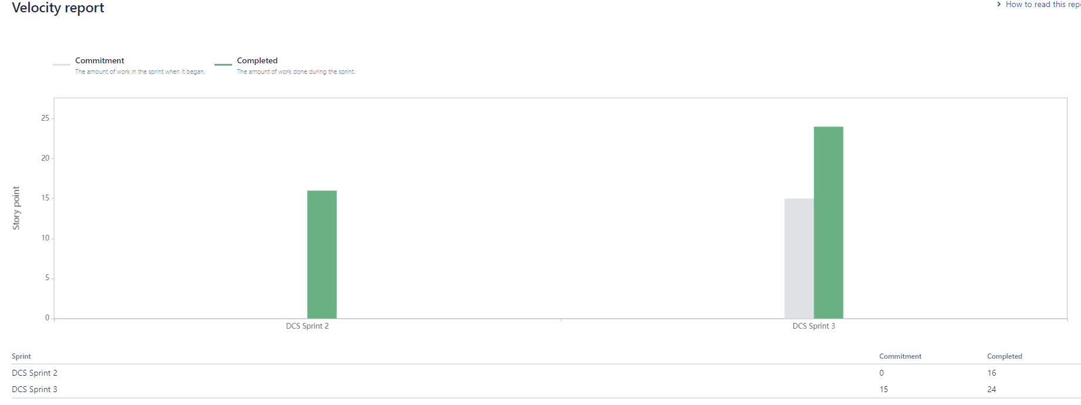
Team Velocity

Slide 34
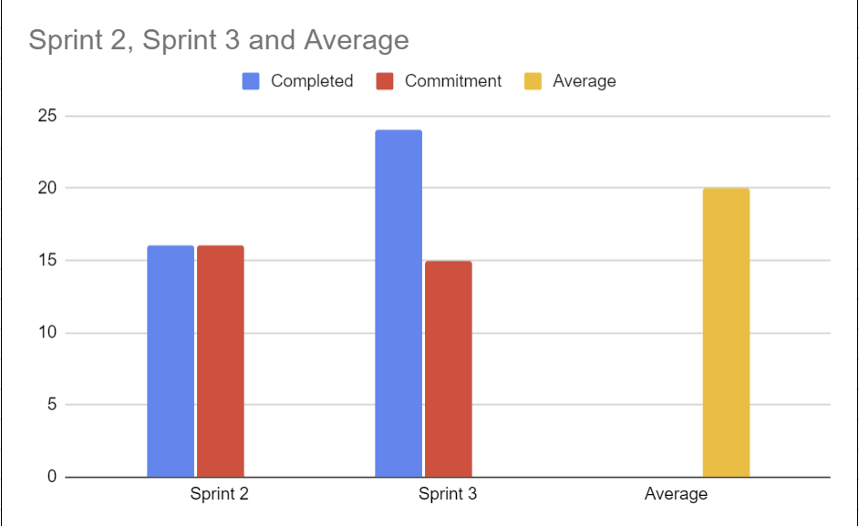
Team History Velocity (Average)

Slide 35
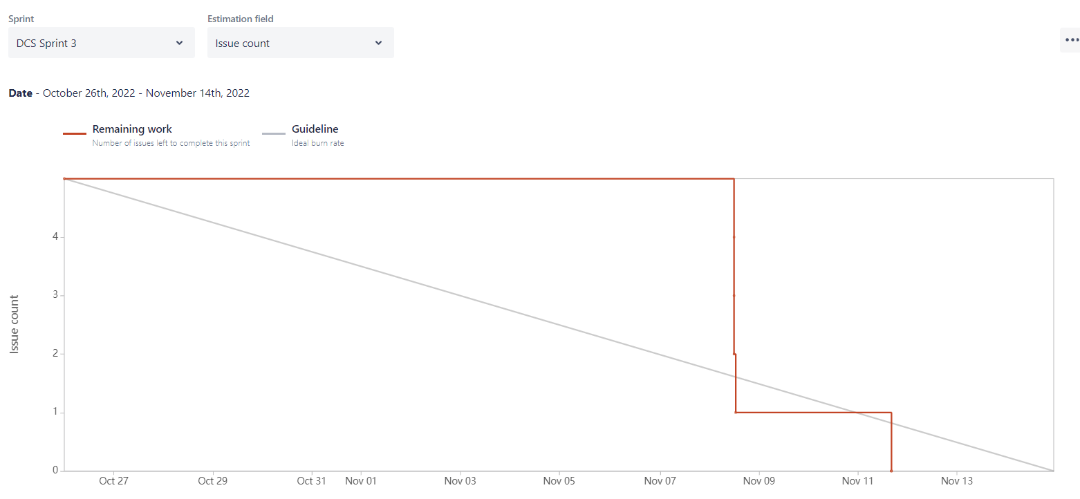
Burndown Charts

Slide 36
Committed/Completed Ratio

Slide 37

Retrospective

Slide 38
What Went Well
Good Collaboration and pairing work done despite remote work.
Team Bonding became strong.
Started working in pairs to complete huge and difficult tasks.
Deliverables on time.
Meetings were short and to the point.

Slide 39
What needs Improvement
Meeting times
Coding redundancies
Discussions about what should be done in the presentations and sprints should be discussed in every meeting.
Updates on how much the work is done should be discussed in the meetings.

Slide 40
Next Steps
Establish a better availability window for meetings.
Guarantee all stories have clear acceptance criteria before picking them up.
Plan for fewer story points.
Discussions on presentation topics and iterative updating of the presentation.

Slide 41
Sprint 4
Issue Type | Key | Name | Status
Story | DCS-52 | As a customer, I want a navigation bar to go between pages, log in and out, and search for specific events so that I may use the app more effectively. | In progress
Story | DCS-50 | As a customer, I want to explore a list of professionals in service, So that I can book an appointment with a professional. | To-do
Story | DCS-24 | As a customer, I want to able to search on the app, So that I can find the necessary information | To-do
Story | DCS-23 | As a customer, I want to choose the date and time of service, So it is available at my convenience. | To-do
Task | DCS-26 | Finish technical paper | To do

Slide 42
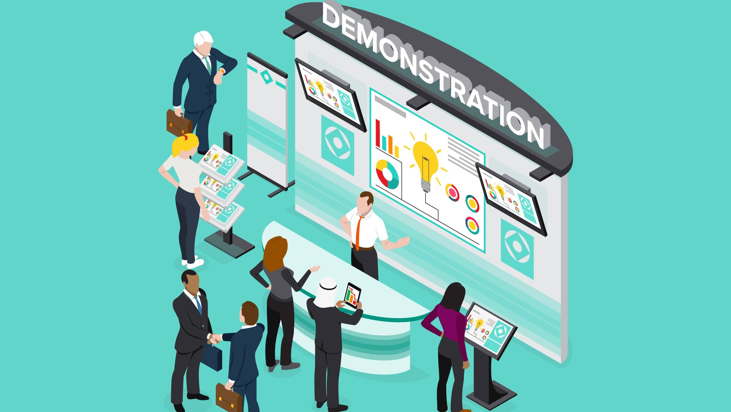
Project Demo – Sprint 3

Slide 43

Slides App Screenshot

Slide 44
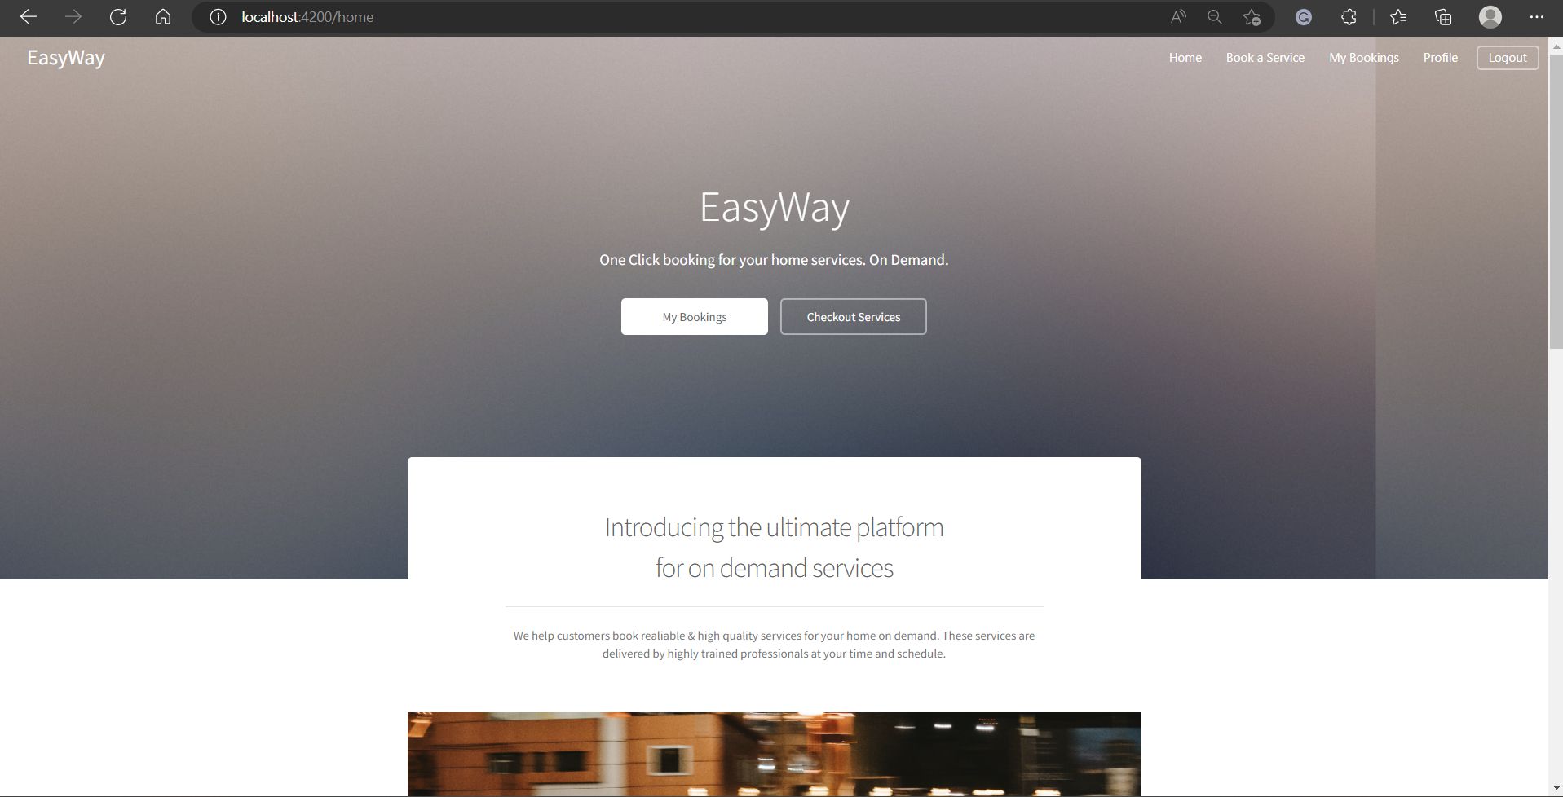
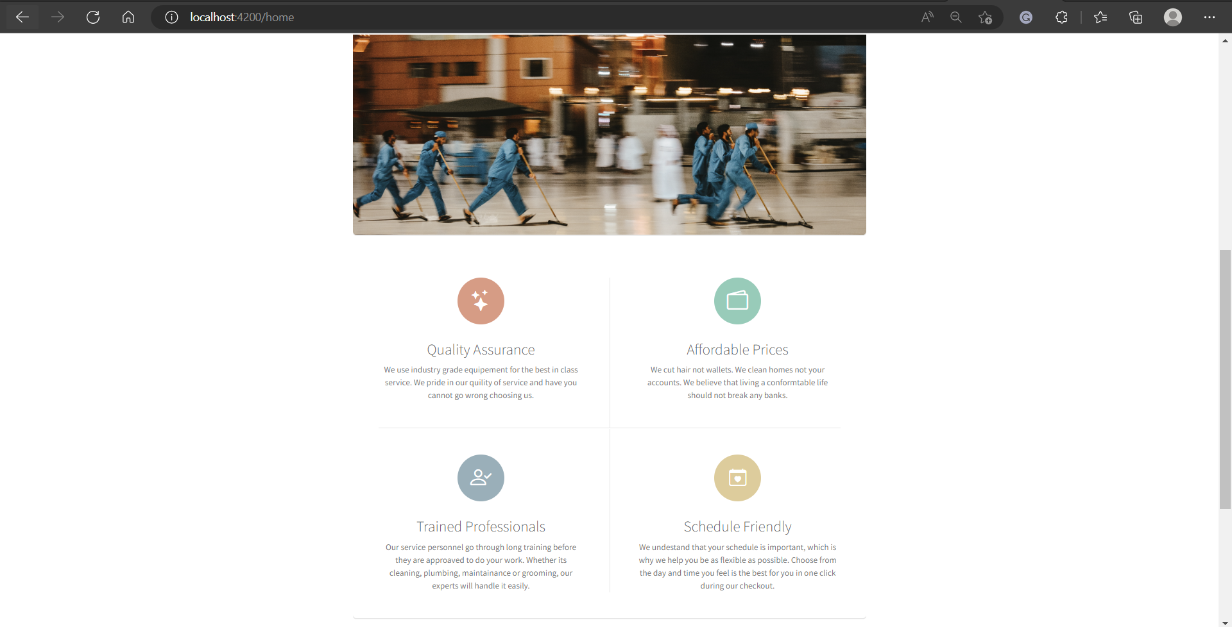
Homepage

Slide 45
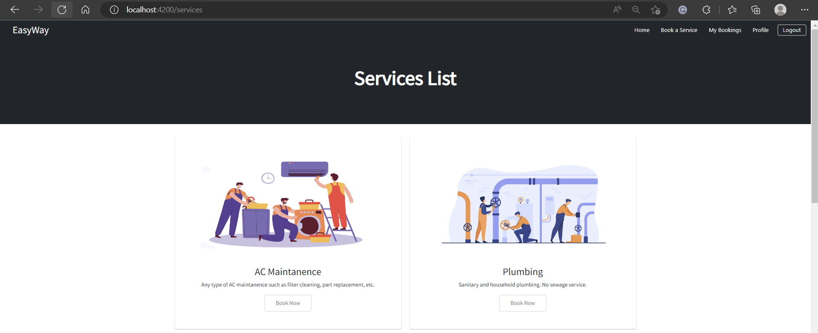
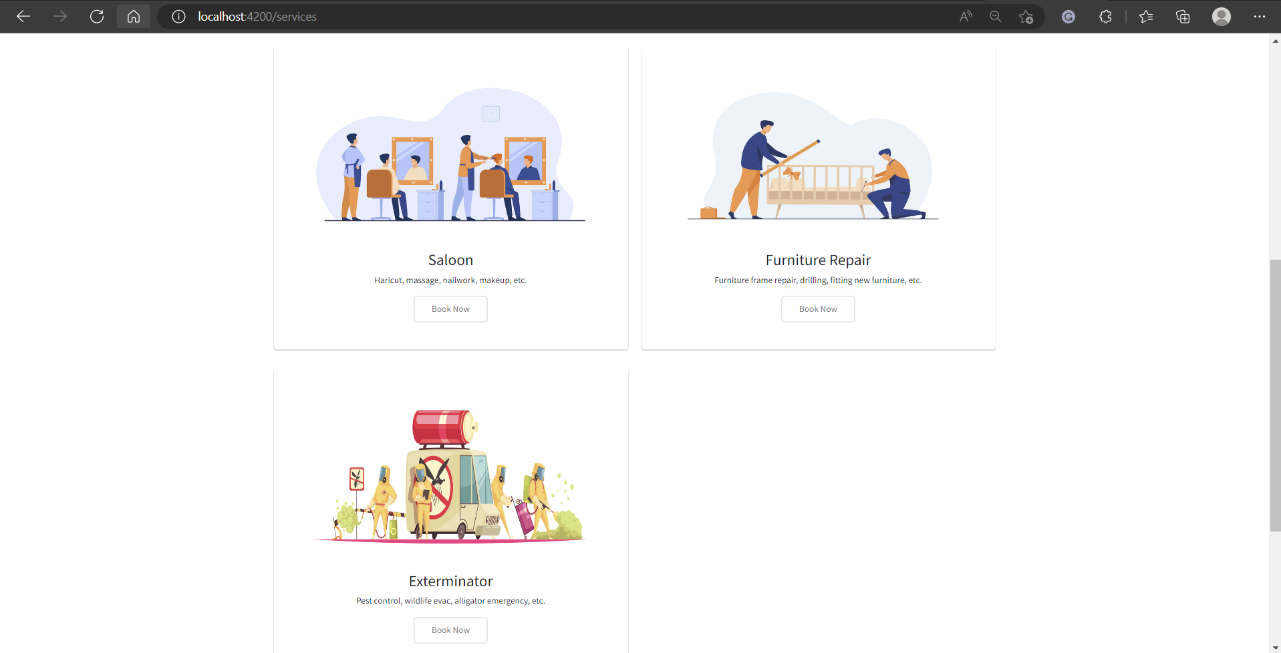
Service Catalog

Slide 46
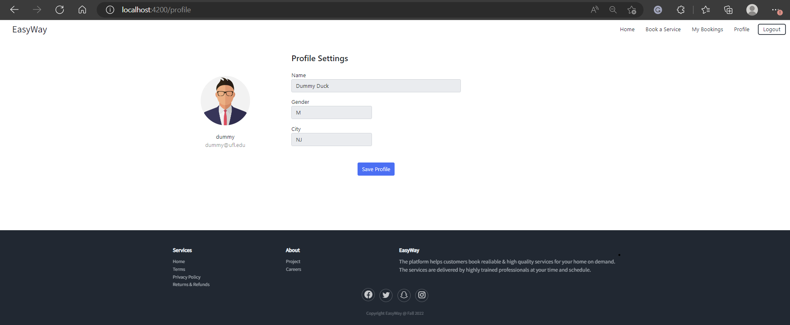
Customer Profile Page

Slide 47
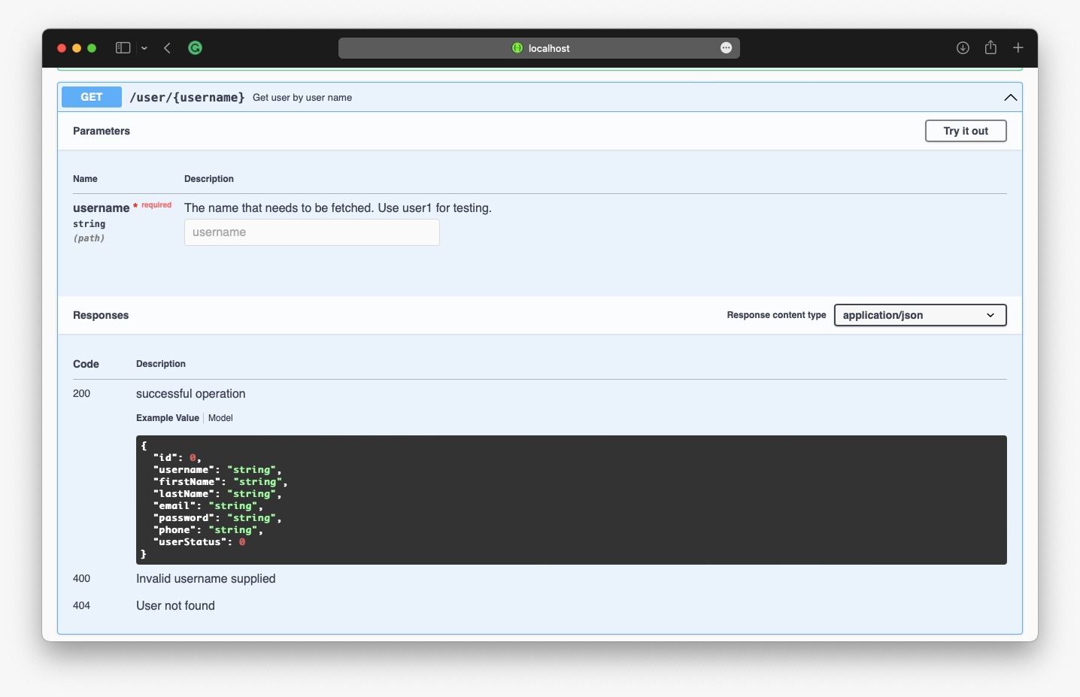
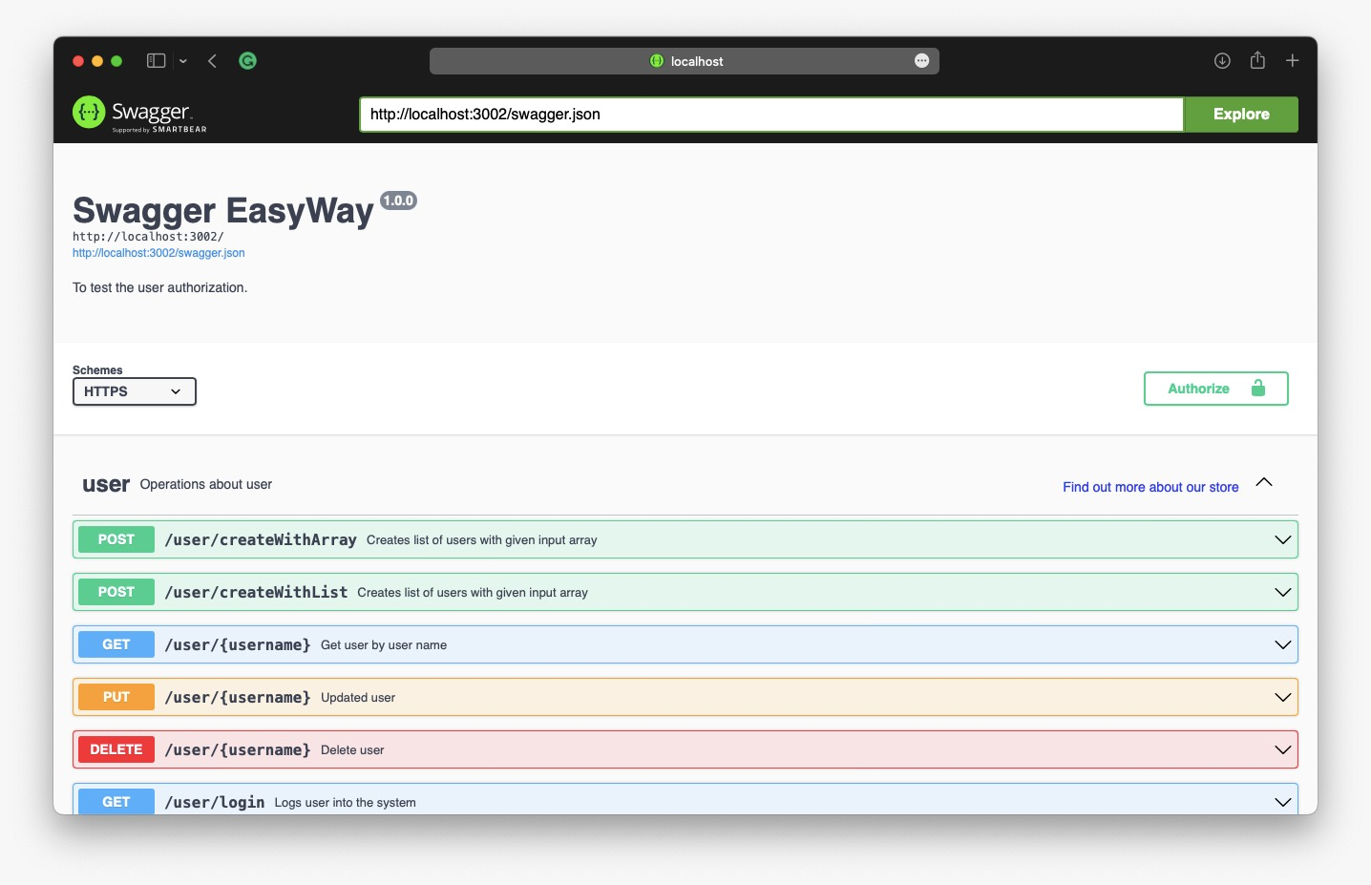
Slides for API

Slide 48

GitHub Link
Home · ksharma67/EasyWay Wiki (github.com)
Technical Paper Link
EASYWAY TECHNICAL PAPER (GITHUB.COM)

Slide 49

Live Application Demo

Slide 50
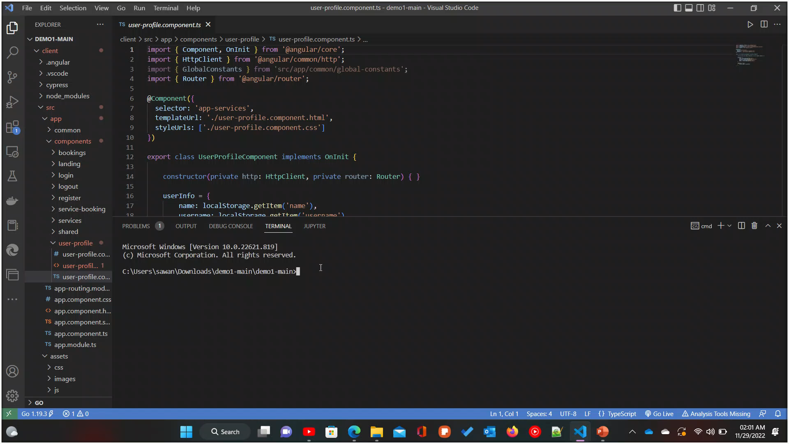
Live Application Demo

Slide 51


